Slide 1
Fluid Catalytic Cracking: Process Design and Economics
Basir Miah
Christian Pena
Slah Yehya
Jameel Hammad
Notes:
Good Morning, my name is Slah Yehya; and beside me are Basir Miah, Christian Pena, and Jameel Hammad. We are here today to present to you our Fluid Catalytic Cracking process design.

Slide 2
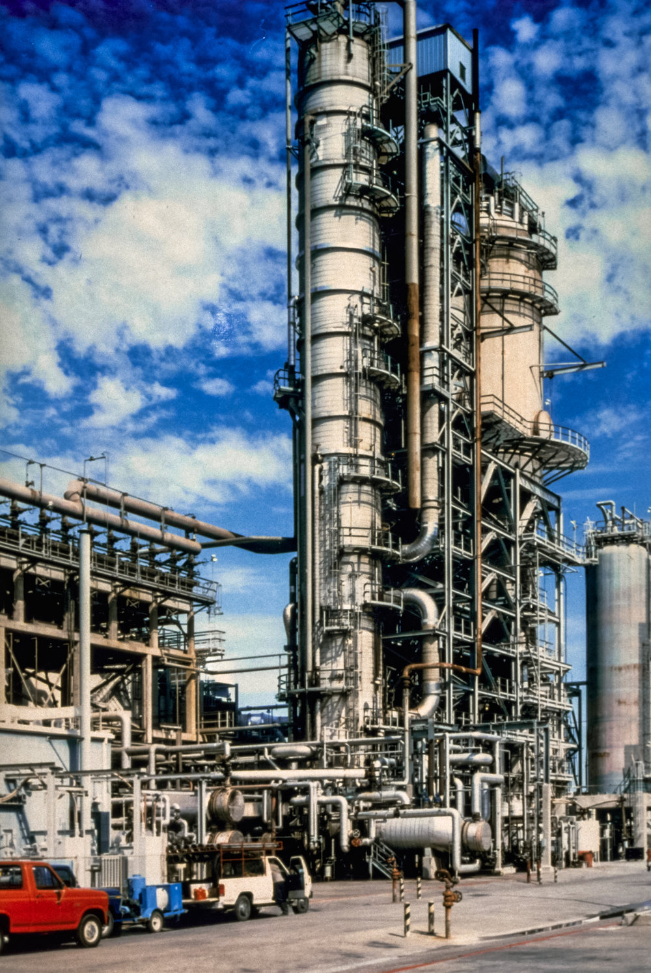
Introduction
According to the U.S. EIA, there are 700 petroleum refineries worldwide, roughly 500 of these facilities utilize FCC (processing 56,000 to 227,000 bbl/cd per unit).
In petroleum refineries, cracking is a process where high- molecular weight hydrocarbons are broken into lighter hydrocarbons.
Fluid Catalytic Cracking (FCC) is a chemical process that converts gas oil into saleable petroleum products, in the presence of zeolite catalyst.
Notes:
According to the Energy Information administration there are 700 petroleum refineries worldwide, and 135 of them are in the United states. 500 of the world petroleum refineries employ Fluid Catalytic Cracking Units, processing 56,000 to 227,000 bbl per calendar day per FCC unit.
In the petroleum field, cracking is known as the process where high boiling, high molecular weight hydrocarbon fractions of petroleum crude oils (known as gas oil) are broken down to form more valuable petroleum products. Cracking of gas oil used to originally be done by Thermal Cracking which has been mostly replaced by Catalytic Cracking because it produces more gasoline, and other products that are more valuable than those produced by thermal cracking. Fluid Catalytic cracking is key to profitability for petroleum refineries, making it one of the main primary processes in petroleum refineries.
The Fluid Catalytic Cracking process vaporizes and breaks down the gas oil molecules to lighter and smaller molecules by contacting the pre heated gas oil at height temperature and moderate pressure with fluidized hot zeolite powdered catalyst.

Slide 3
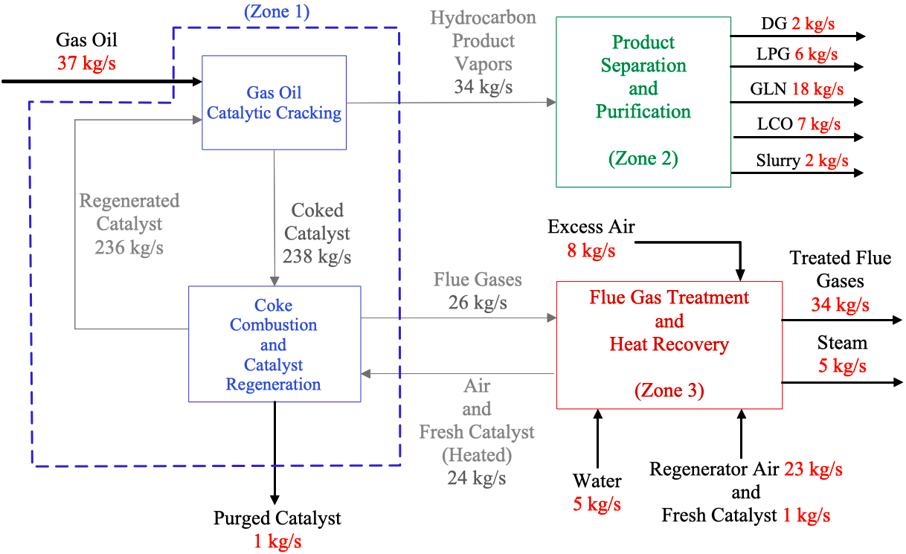
Overall Process: Zone-by-Zone Breakdown
Notes:
Here’s is zone-by-zone breakdown of the overall process.
In Zone 1, gas oil is fed at 37 kg/s and mixes with hot regenerated catalyst, flowing at 236 kg/s. Gas oil converts to hydrocarbon product vapors and coke. Hydrocarbon vapors, flowing at 34 kg/s, enter the Product Separation and Purification Zone (Zone #2) to be separated into various petroleum products. 238 kg/s of coked catalyst mixes with air (which arrives from Zone 3). Coke combusts yielding 26 kg/s of hot flue gases. Flue gases flow to the Flue Gas Treatment and Heat Recovery Zone (Zone #3). Regenerated catalyst circles back to continue the cycle. Catalyst is both purged and added at a rate of 1 kg/s.
Gasoline and LCO are withdrawn from Zone 2 at approx. 18 and 7 kg/s, respectively. DG and LPG emerge from Zone 2 at approx. 2 and 6 kg/s, respectively. Slurry leaves Zone 2 at approx. 2 kg/s.
Hot Flue gases, from Zone 1, are mixed with excess Air, at ambient conditions. Water, flowing at 5 kg/s, is converted to steam. Treated flue gases exit Zone 3 at 34 kg/sec. Air and fresh catalyst, flowing at 24 kg/s, are heated and flow to Zone #1.

Slide 4
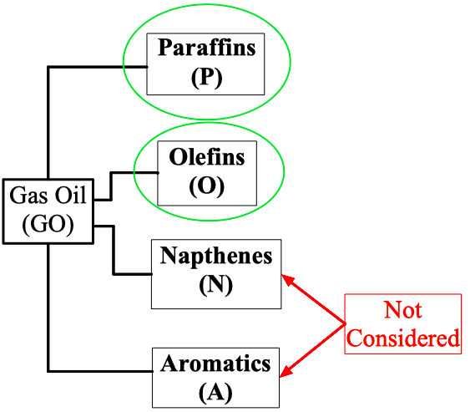
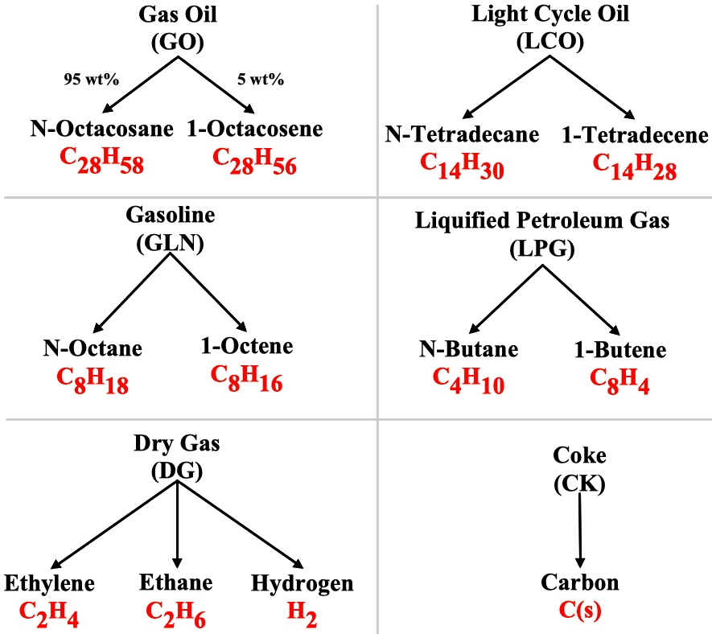
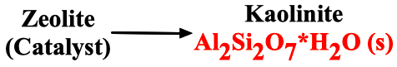
Reactants and Products of Gas Oil Catalytic Cracking
Impurities and contaminants (sulfur, nickel, vanadium, etc.)
were not considered
Notes:
Gas oil consists of numerous hydrocarbon compounds. To simplify the modeling process, a few components were selected to represent various petroleum lumps. Gas oil was modeled as N-Octacosane and 1-Octacosene and figure illustrates which n-alkanes and 1-alkenes were used to model LCO, GLN, LPG, and DG lumps. Coke was modeled using elemental Carbon. Kaolinite was chosen to model the FCC catalyst. Lastly, our design did not consider the Naphthene and Aromatic attributes of typical gas oil. Doing so would make the process modeling significantly more complex. Impurities and contaminants such as sulfur, nickel, and vanadium were not considered.
[LCO was modeled with 2 C₁₄ compounds. N-Octane and 1-Octane represented the Gasoline lump. Two C₄ compounds modeled LPG. DG was modeled as a combination of Ethylene, Ethane, and Hydrogen.].

Slide 5
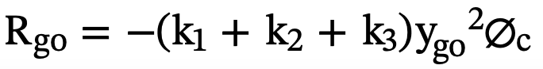
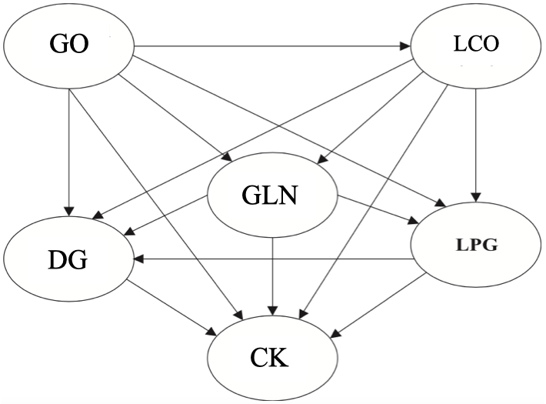
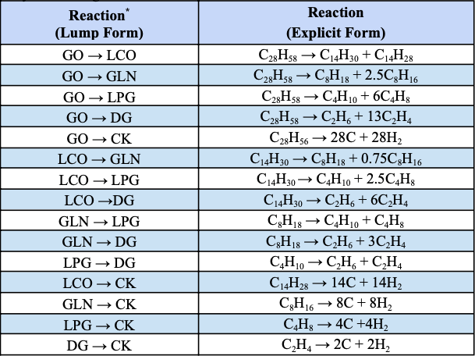
Reaction Kinetics
Model w/ Aspen’s activity factor option
Two Observations in Cracking Chemistry:
Long-Chain Paraffin → Short-Chain Paraffin + Olefin
Olefin → Coke
Notes:
A 6-lump kinetic scheme was adopted for modeling the catalytic cracking of gas oil. Usually, the number of lumps indicates the total number of reactants and products in the reaction (i.e., 6 components are present in a 6-lump model). Aspen allows users to multiply reaction kinetic parameters by multiplicative factors called activities. Activity factors were incorporated into the reactions to model the catalyst deactivation which lowers the yield of certain hydrocarbon products as coke is deposited onto the catalyst surface. The table, on the lower right, lists 15 reactions developed by the design team. Important to note, only the cracking of long, straight-chain paraffins and conversion of olefins to coke were considered. The reaction rates are 2nd order w.r.t. Gas Oil, 1st order w.r.t. every other component, and irreversible.

Slide 6
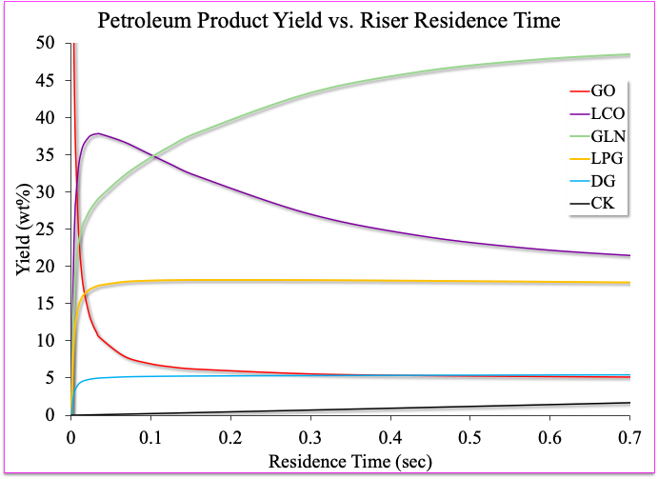
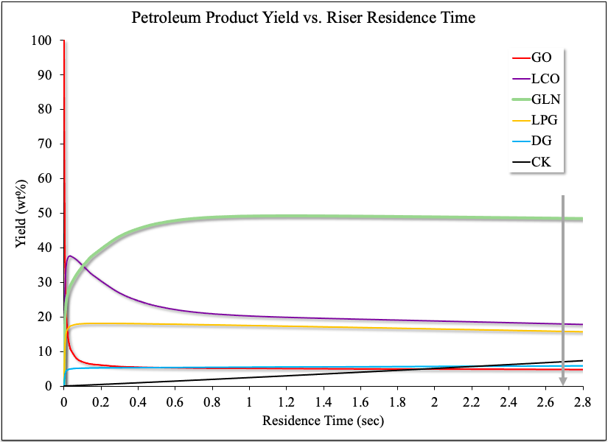
Riser Yield Profiles
Residence Time (RPlug): 2.7 seconds
Gas Oil Conversion: 95 wt%
C/O Ratio: 6.4 kg catalyst/kg gas oil
Simulation Yield Commercial Yield
GLN 49 wt% 46 - 51 wt%
LPG 16 wt% 12 - 15 wt%
LCO 18 wt% 15 - 23 wt%
DG 6 wt% ~ 5 wt% CK 7 wt% 4 - 6 wt%
Notes:
The figures show “petroleum product yield profiles vs riser residence time”
The residence time, corresponding to our reactor configuration, is 2.7 seconds (marked by the grey arrow). This is consistent with industrial riser residence times ranging between 2-4 seconds.
In addition, 95% of gas oil converts to product and the employed catalyst-to-oil ratio is 6.4.
The yield of gasoline, LPG, DG, and LCO hardly change after 0.7 seconds. However, the yield of coke shows no sign of flattening out.
The table below compares our simulations yields to yield commonly reported in industry. Overall, our simulation yields are in-alignment with commercial yields.

Slide 7
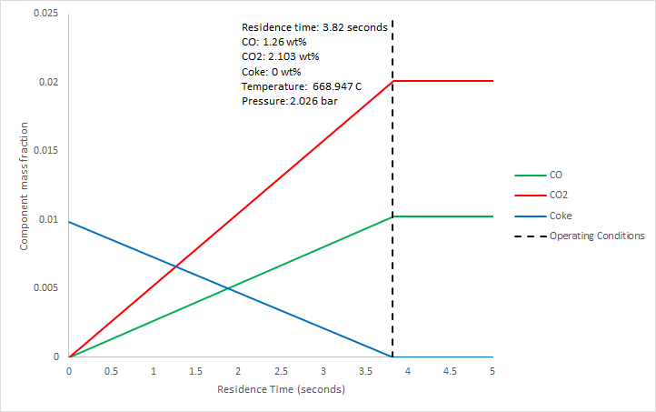
Regenerator
Used to burn off the solid coke generated in the riser reactor from the catalyst.
Coke burns and forms CO and CO₂.
The outlet enters a solid cyclone in which the regenerated catalyst is separated from the gases generated from the burning of the coke.

Slide 8
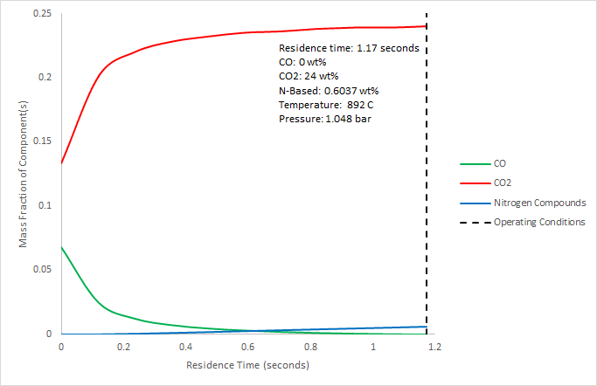
CO Boiler
Comprised of a furnace and heat exchanger.
Treats the gases coming from the regenerator outlet to ensure that excess CO is not emitted into the environment.
Reactions have also been included to model the formation of nitrogen based pollutants during combustion.
The hot flue gases that are emitted enter a heat exchanger where they are used to heat water to generate steam.

Slide 9
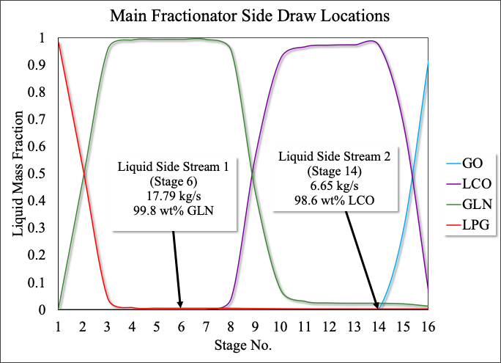
Petroleum Product Fractionation (Zone 2)
Compound | GLN | LCO
Purity (wt%) | 99.8 | 98.6
Recovery (wt%) | 99.5 | 99.0
Stage No. | 6 | 14
Flow Rate (kg/s) | 17.79 | 6.65
Lighter gases (LPG and DG) comprise the overhead distillate and are further separated
Bottoms product (Slurry) contains unreacted gas oil
and ~ 4 wt% LCO
Notes:
Liquid side streams were integrated on stages that were rich in a particular component. The column operates at ~ 1 bar. Stages 6 and 14 correspond to liquid mass fractions of 99.8 wt% gasoline and 98.6 wt% light cycle oil, respectively. The table, on the upper right, summarizes the purity, recovery, and flow rates of the GLN- and LCO-rich side draws. The overhead distillate consists of lighter gases and is further separated. And, the bottoms product, denoted as Slurry, contains unreacted gas oil and residual LCO.

Slide 10
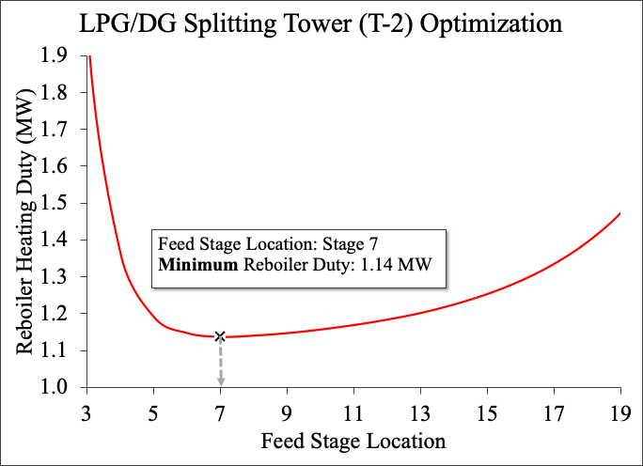
Petroleum Product Fractionation (Zone 2)
Variables held constant:
Purity Targets (via Design-Spec)
Number of Stages (30)
Operating Pressure (~ 29 bar)
Feed Composition, Temperature, Pressure, and Flow Rate
Compound | DG | LPG
Purity (wt%) | 99.9 | 99.9
Recovery (wt%) | 99.8 | 99.2
Stage No. | 1 | 30
Flow Rate (kg/s) | 2.16 | 5.76
Notes:
For the secondary distillation column, we performed a sensitivity analysis to determine the optimum feed stage location. Here, the reboiler heating duty was allowed to vary with respect to the feed stage location. At a feed stage location of Stage 7, the minimum reboiler heating duty is approximately 1.14 MW. Lowering the reboiler heating duty reduced the heating utilities cost associated with the LPG/DG Splitting Tower. The table, on the bottom right, summarizes the purity, recovery, and mass flow rate of Dry Gas and LPG exiting the tower.

Slide 11
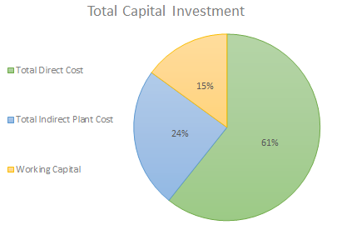
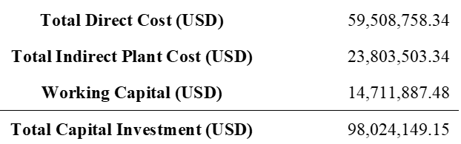
Breakdown of Capital Investment
Total Direct Cost includes purchased equipment, installation, instrumentation and controls, electrical systems, land, etc.
Total Indirect Cost includes engineering an supervision, construction, legal expenses, and contingency.
The working capital was estimated to be 89% of the purchased equipment cost and is required to get us up and running.

Slide 12
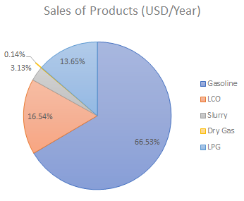
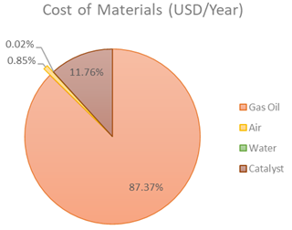
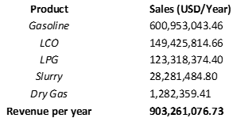
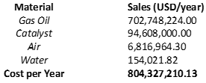
Economic Analysis (Annual Sales and Cost of Materials)

Slide 13
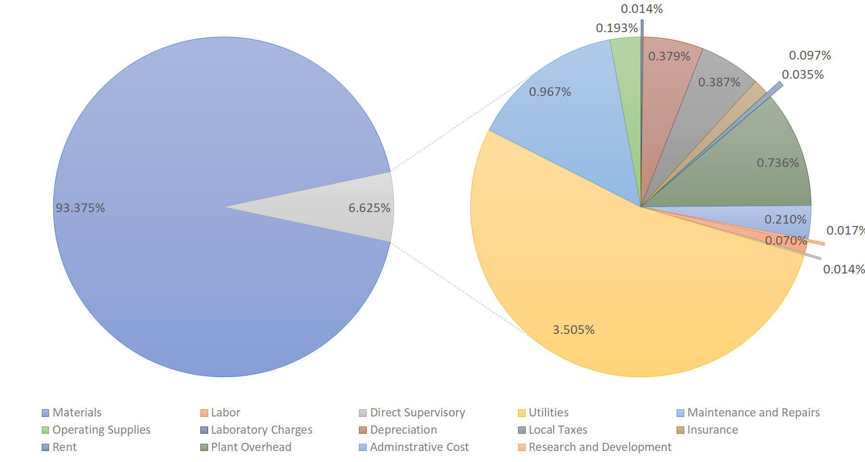
Breakdown of Total Operation and Maintenance Costs

Slide 14
Revenue, Costs, Profit, ROI, and Payback Period
Revenue (USD/Year) | 903,261,076.7
Costs of Materials (USD/Year) | 804,327,210.1
Annualized Capital Cost (USD/Year) | 9,802,414.915
O&M Costs (USD/Year) | 57,053,144.11
Profit Before Taxes (USD/Year) | 32,078,307.57
Profit After Taxes (USD/Year) | 21,492,466.07
ROI | 3.68 %
Payback Period | 4.60 Years
Revenue is approximately 903 million dollars. Total operating and maintenance cost is about 861 million dollars. Annualized capital cost is almost 10 million dollars. After taxes, we have a profit of almost 21 million dollars.
Revenue, costs, profit, ROI, and payback period were all determined accounting for depreciation, a yearly inflation of 3%, a discount factor of 10%, and a flat tax rate of 33%.

Slide 15
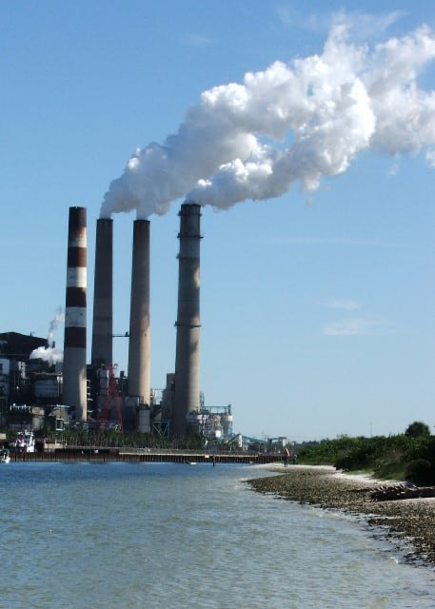
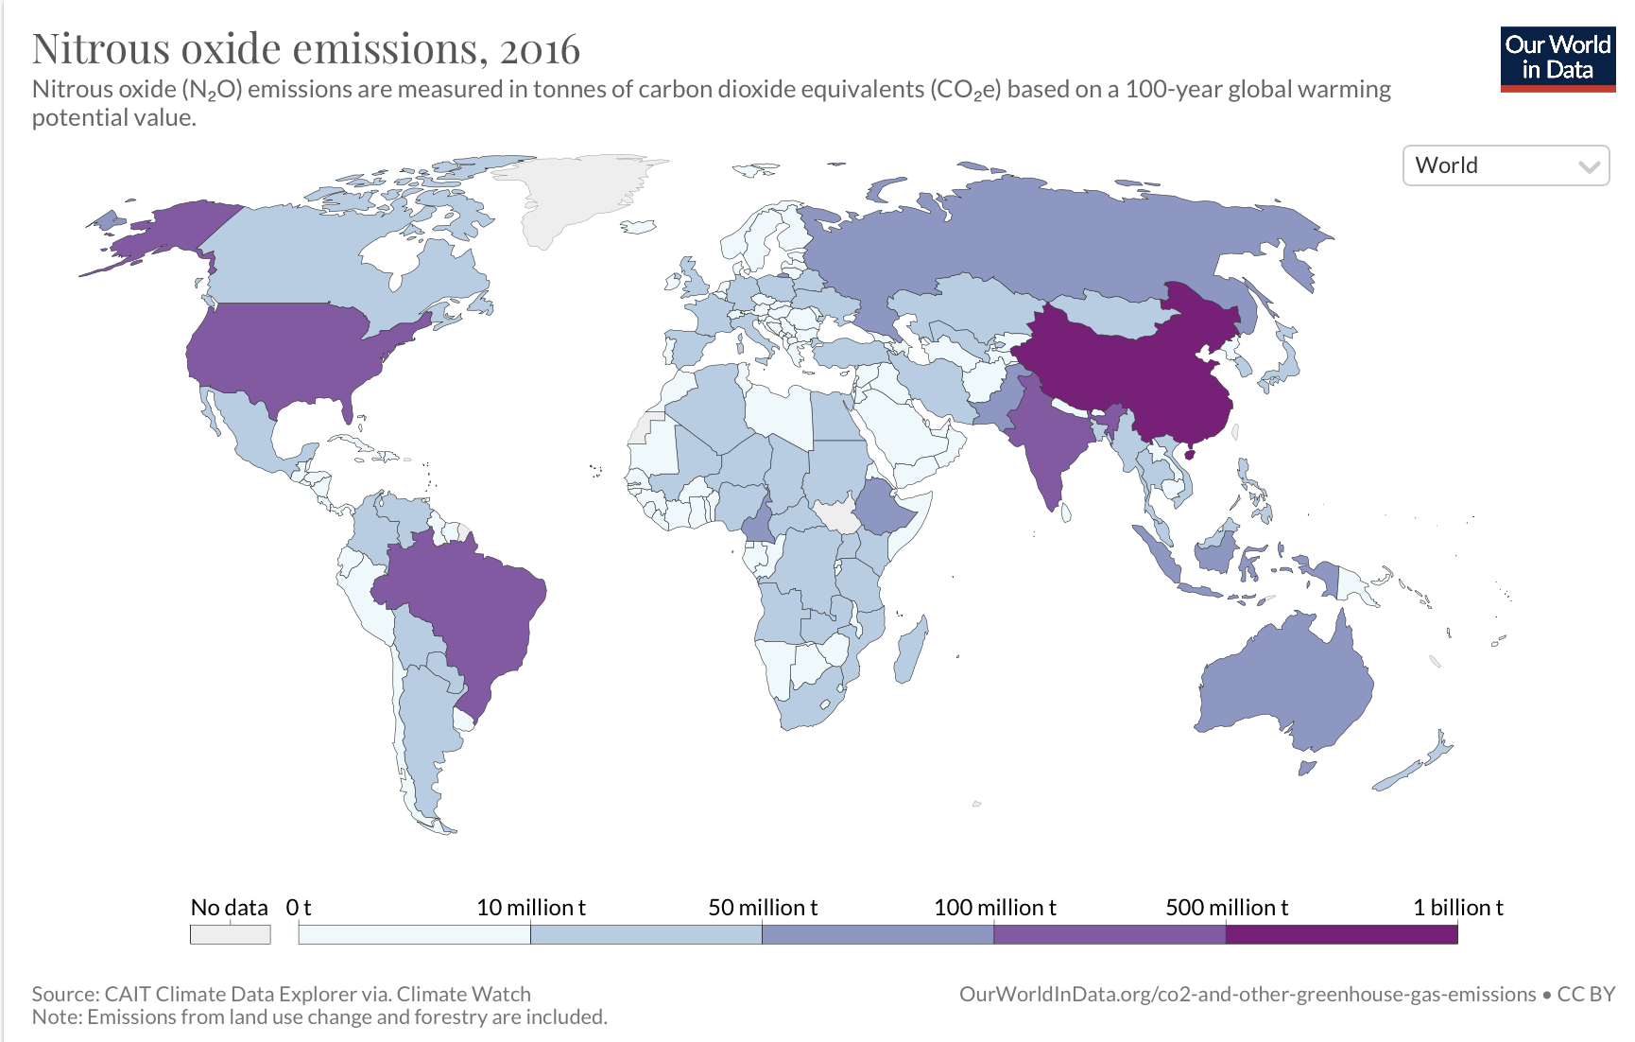
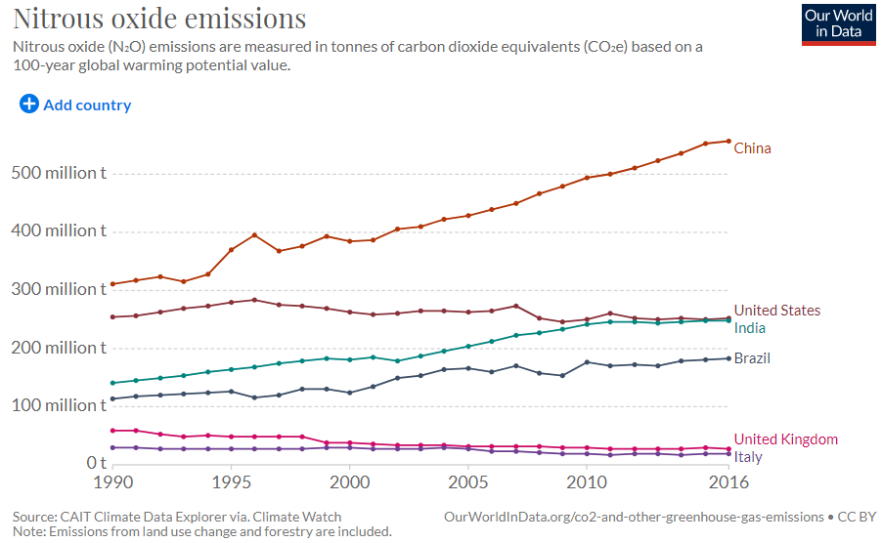
Environment, Health, and Safety
Most of the environmental concerns are due to flue gas emission to the atmosphere primarily by producing NOx (nitric oxide) compounds
Refineries in the U.S. are operating under consent an agreement with the EPA to lower air emissions from their FCC units.
EPA limits allowable NOx emission to the atmosphere to 20 ppm.
Notes:
Petroleum refineries are held accountable for water, air and soil pollution all around the world. They are required by state, local, and federal environmental agencies to meet certain air quality emission limits. If we look at the map on top, we can see the huge amounts of NOx emissions are produced through the world. China holding the first place by producing around 550 million tons of NOx, following the USA with around 250 million tons.
Most of the concerns that the Environmental Protection Agency are due to the Nitric Oxide emissions into the atmosphere. In the United States refineries are forced by the EPA to lower air emissions produced from FCCU. EPA passed a law limiting the allowable nitric oxide emission to the atmosphere to be 20ppm per unit.

Slide 16
Environment, Health, and Safety
General and Environmental Hazards of FCC Products and Reactants
Gas Oil | Oil spills contaminate land and water; deadly to animals. Air and water pollution hurts local communities.
LCO | Toxic to aquatic life, with a long term effect on its environment. May be fatal if swallowed or enters airways. Can cause skin and eye irritation.
Gasoline
LPG | Skin and eye irritant. May cause explosive mixture with air. At high concentration, may displace oxygen and cause suffocation.
Dry Gas | Extremely flammable gas.
Catalyst (Zeolite Y) | May cause respiratory irritation if inhaled.
Notes:
These are the general and health hazards of FCC products, reactants and media used. Gas oil produces dangerous emissions that contributes to climate change. In addition to that we all know how oil spills contaminate land and waters and how dangerous it’s to the environments and to aquatic life. LCO and Gasoline share the same hazards, where they can also be toxic to aquatic life in a long term. It can also be fatal or cause serious injuries if not handled carefully because it’s very flammable. LPG in the other hand can be explosive if mixed with air. At high concentration it can also displace oxygen and cause suffocation. Dry gas is extremely flammable and just like LPG can cause suffocation. Finally, the Zeolite catalyst, which doesn’t have dangerous hazards unless inhaled, where it can cause respiratory irritations.

Slide 17
Thank You!

Slide 18
Questions?

Slide 19
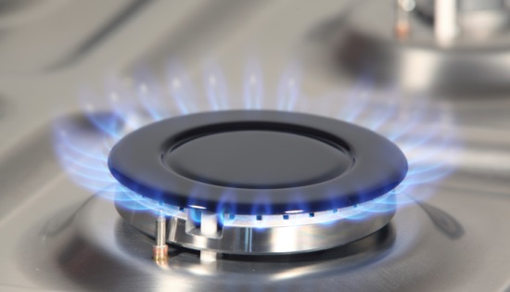
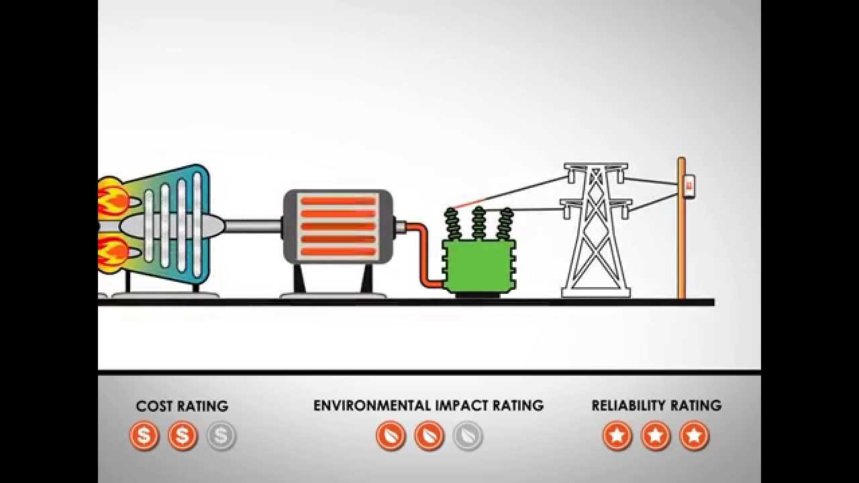
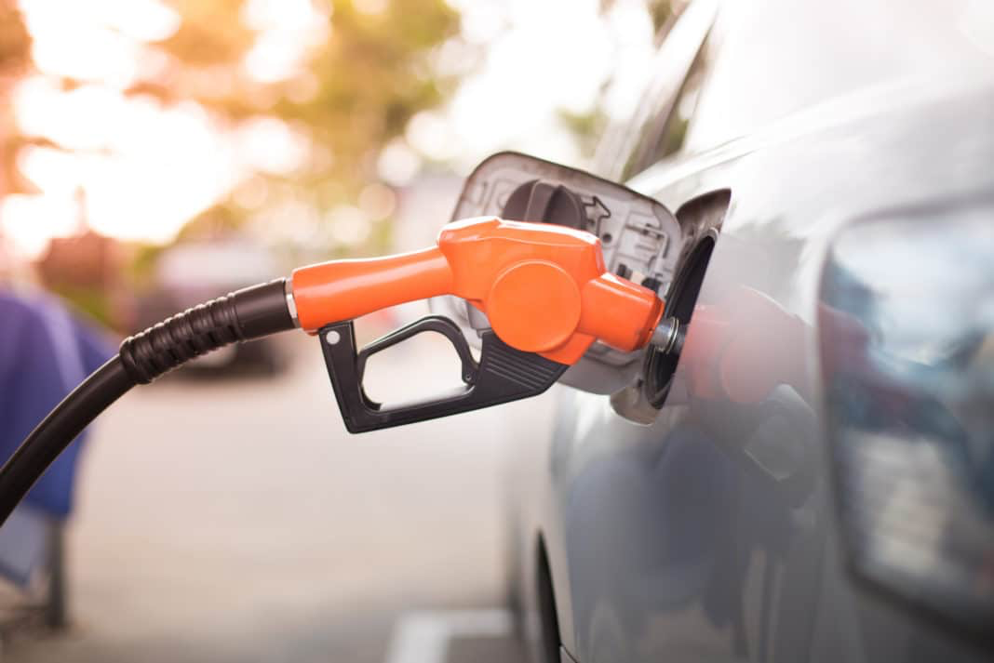
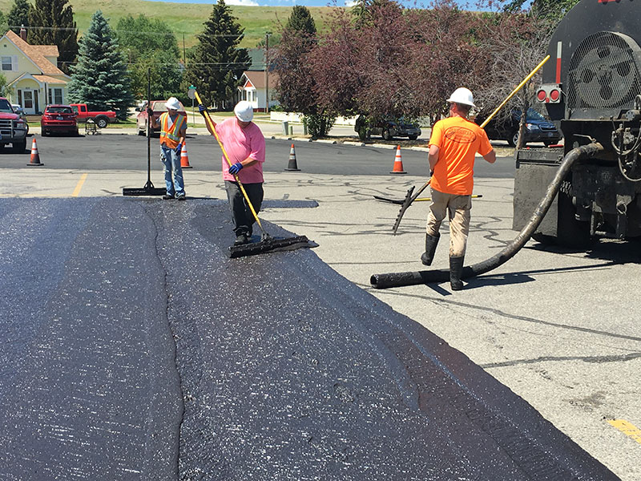
Applications
Dry Gas
Generate electricity
Fuel for process heating
Heat buildings and water
Fuel to operate compressors
Liquified Petroleum Gas
Vehicle fuel
Cooking
Gasoline
Fuel for vehicles, boats, and small aircraft… etc.
Light Cycle Oil
Fuel usually for larger, commercial automobiles
Slurry
Asphalt base for roads
Heating oil for engines

Slide 20
Thermal cracking vs. Catalytic cracking
Thermal cracking | Catalytic cracking
Involves cracking by applying temperature that ranges from 500 to 700 degrees Celsius. | Involves cracking by applying temperature that ranges from 475 to 530 degrees Celsius.
Requires high pressure (around 70 atm) | Can go under relatively low pressure ( >20 atm)
Used to obtain high yield of C2 and C3 olefins and low yield of gasoline and other distillates | Used to obtain high yield of C4 olefins and high yield of gasoline and other distillates
Produces thermal gasoline (low octane number) | Produces gasoline with higher octane number
Doesn’t use catalyst | Uses catalyst

Slide 21
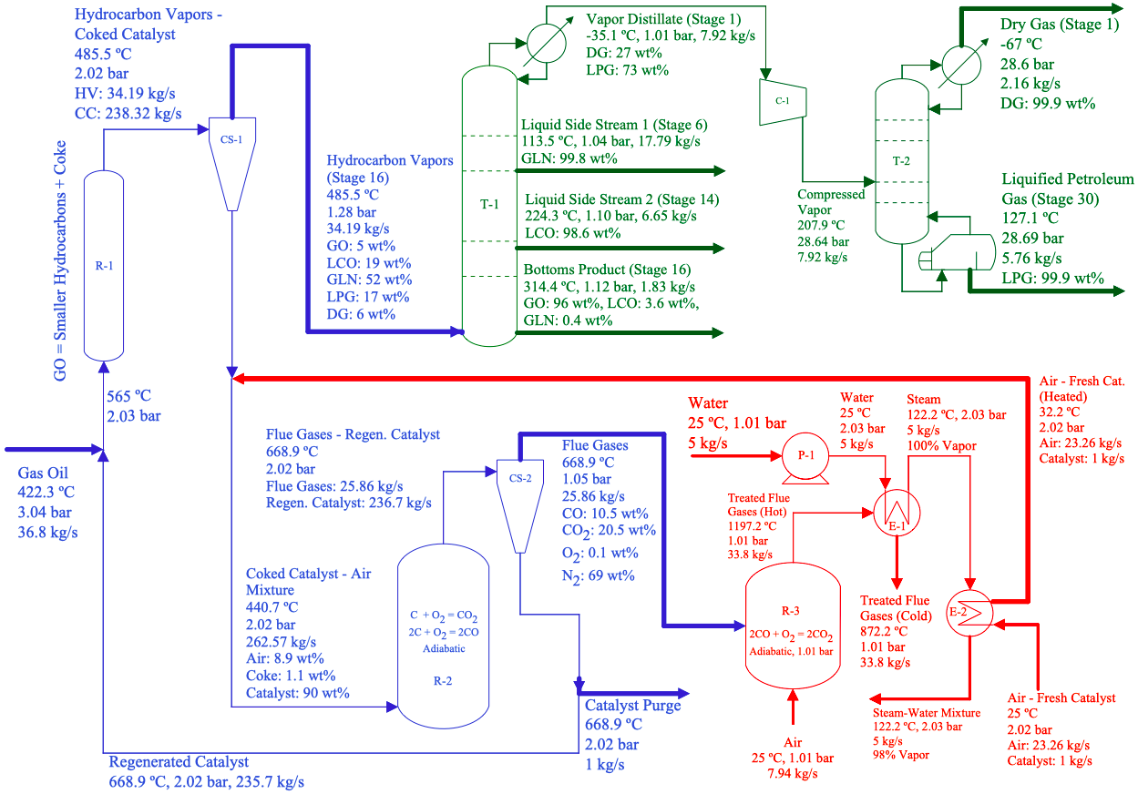
Process Flow Diagram
Notes:
Here, is a color-coded version of the Process Flow Diagram. All the essentials zones have been combined.
(Wait 5 seconds → Next Slide Please).

Slide 22
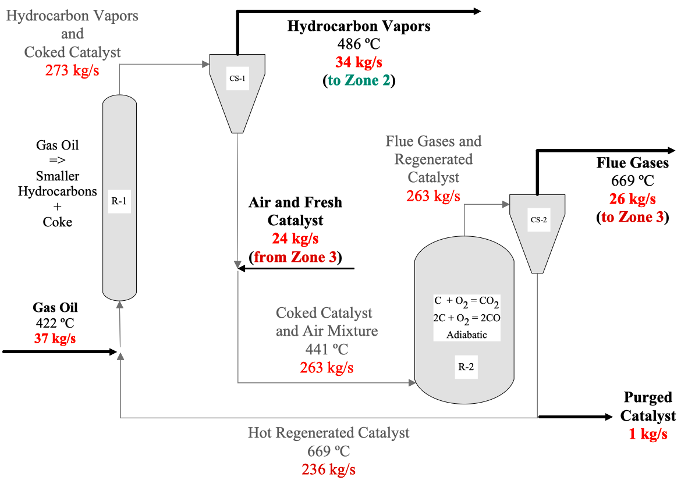
Zone 1: Gas Oil Cracking and Catalyst Regeneration
Notes:
In Zone 1, gas oil mixes with heated zeolite catalyst and vaporizes. The catalyst particles fluidize, and the gas-solid mixture travels upward and into the riser where gas oil is catalytically converted into LCO, GLN, LPG, DG, and CK. Hydrocarbon vapors and coked catalyst emerge from the riser and are separated by a single cyclone separator. Hydrocarbon vapors flow to the main fractionator, which is located in Zone 2. Coked catalyst mixes with air (from Zone 3) and the fuel-air mixture is fed to the regenerator where coke combusts completely yielding CO/CO2-rich flue gases. Flue gases and regenerated catalyst are separated by a single cyclone separator. Flue gases flow upwards and into the CO Boiler (located in Zone 3). Lastly, regenerated catalyst circles back to complete the cycle.

Slide 23
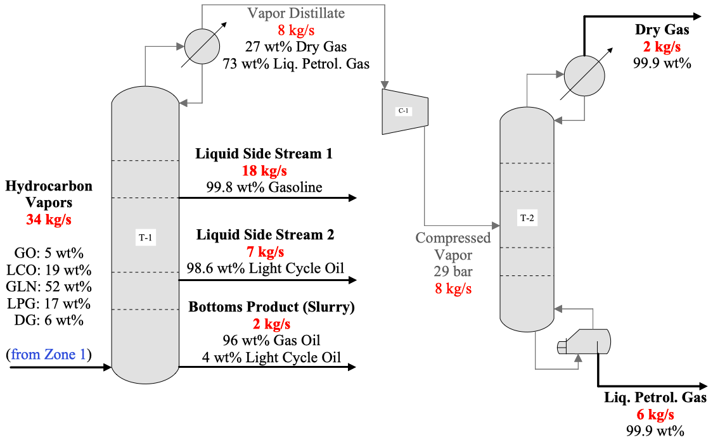
Zone 2: Product Separation and Purification
Column (T-2)
Pressure ~ 28 - 29 bar
Notes:
Hydrocarbon vapors (from Zone 1) are fed to the main fractionator’s base at approximately 34 kg/sec. Side stream 1 consists of 99.8 wt% gasoline flowing at approximately 18/sec, while side stream 2 consist of 98.6 wt% LCO flowing at approximately 7 kg/sec. The bottoms products contains unreacted gas oil, 4 wt% LCO, and is treated as Slurry. The overhead vapor distillate consists of 27 wt% DG and 73 wt% LPG and is further separated in the secondary distillation column. In the second tower: the vapor distillate consists of 99.9 wt% DG flowing at approx. 2 kg/sec and the liquid bottoms product consists of 99.9 wt% LPG flowing at approx. 6 kg/sec.
Hydrocarbon product vapors, flowing at 34 kg/s, enter the main fractionator, through the base, and are separated into gasoline, light cycle oil, an overhead vapor distillate consisting of dry gas and liquified petroleum gas, and a bottoms product consisting of mostly unreacted gas oil. There are two liquid side streams; one side side stream withdraws gasoline-rich liquid from stage 6 (99.8 wt% gasoline at 17.8 kg/s) and the second side stream withdraws light cycle oil-rich liquid from stage 14 (98.7 wt% light cycle oil at 6.65 kg/s).
The bottoms product consists of unreacted gas oil, light cycle oil, trace amounts of gasoline and flows at 2 kg/s (i.e., the bottoms product is considered slurry). The overheard vapor distillate flows at 8 kg/s and requires further separation (i.e., 27 wt% dry gas and 73 wt% liquified petroleum gas). A compressor is employed to pressurize the vapor distillate to an outlet pressure of 29 bar. Lastly, the compressed vapor enters a 30-stage column operating at ~29 bar where it is separated into dry gas (99.9 wt%) and liquified petroleum gas (99.9 wt%).

Slide 24
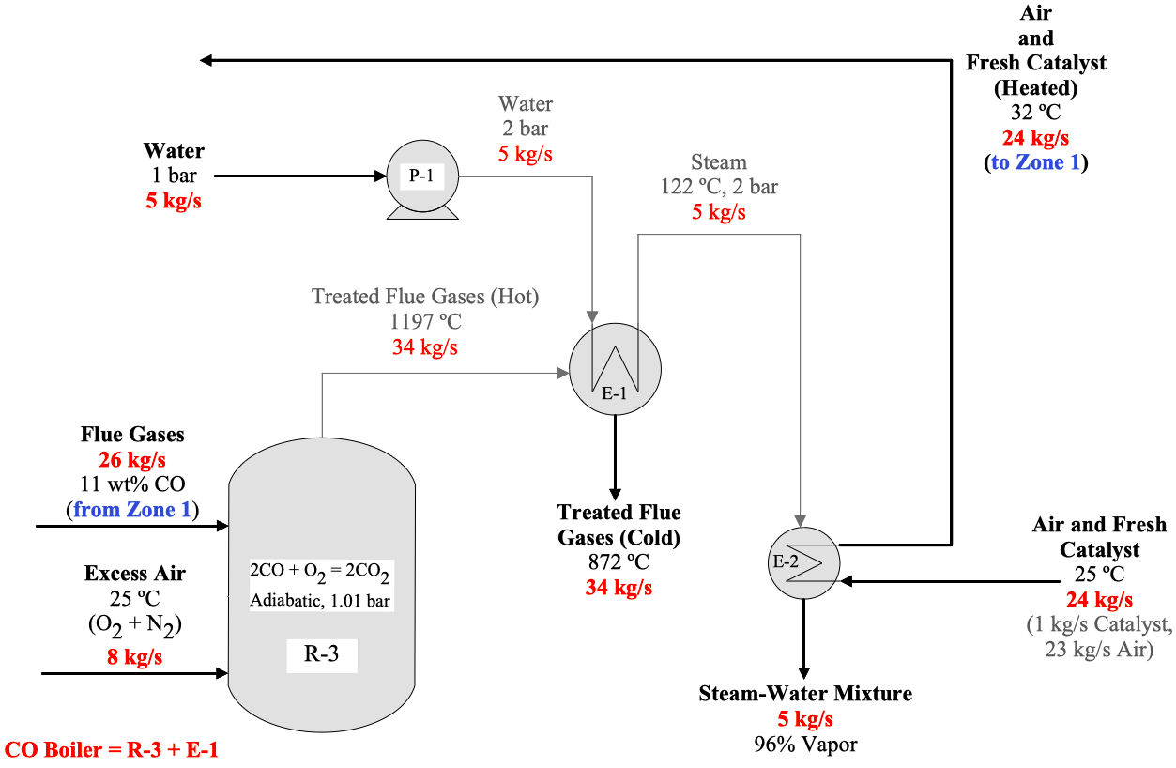
Zone 3: Flue Gas Treatment and Heat Recovery
Notes:
Flue gases, from Zone 1, are mixed with excess Air, at ambient conditions, to burn CO and produce gases dischargeable to the atmosphere. Treated flue gases pass through a heater where pressurized water, flowing at 5 kg/sec, heats-up and converts to steam. Steam functions as a heating utility, raising the temperature of fresh catalyst and atmospheric air (from 25 to 32 ºC). Heated Air and catalyst flow to Zone 1.

Slide 25
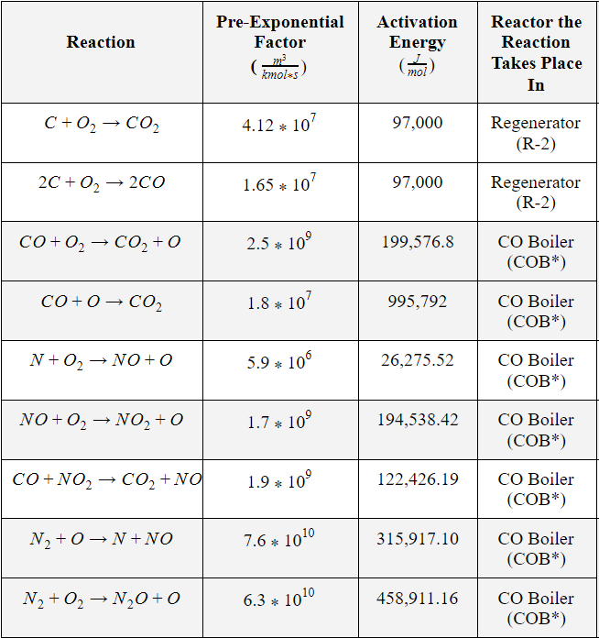
Full Set of Regenerator and CO Boiler Reactions

Slide 26
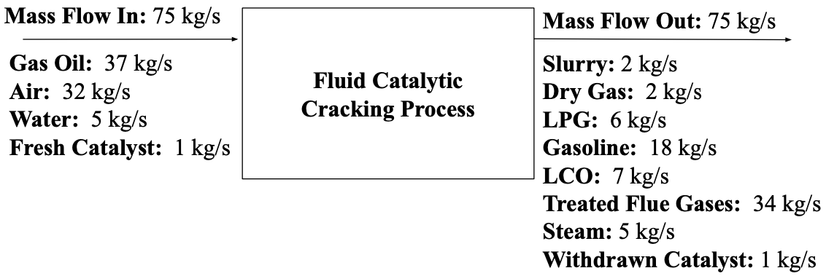
Overall Mass Balance

Slide 27
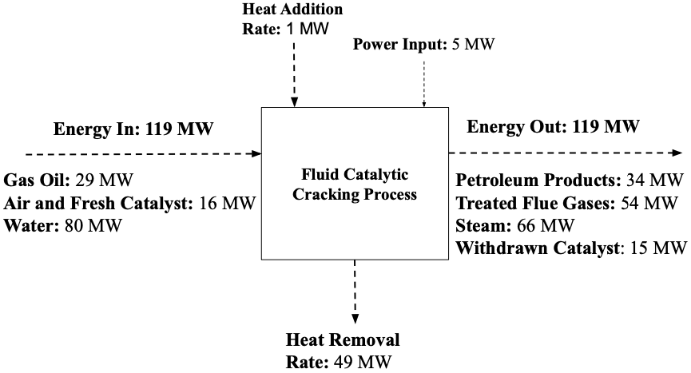
Overall Energy Balance

Slide 28
Deriving Lumped Reactions (Part 1)
Take for example the reaction: GO → LCO (1 of 15 reactions in the 6-lump network)
Important Data:
Lump | Gas Oil (GO) | Light Cycle Oil (LCO)
Boiling Point (Range) | 330 - 550 ºC | 221+ ºC
Molecular Weight | ~ 400 g/mol | ~ 200 g/mol
Model Component (N-Alkane) | N-Octacosane (C₂₈H₅₈) | N-Tetradecane (C₁₄H₃₀)
Now, let’s put it together:
GO → LCO
C₂₈H₅₈ → C₁₄H₃₀ + ?
Stoichiometry is NOT balanced; need
additional compound(s)
What should we do now? How do we go about choosing this second compound?
Part 2
Notes:
We know that GO has a boiling range between 330 - 550 ºC. In addition, we’re considering long, straight-chain alkanes (i.e., n-alkanes). One more thing: gas oil has a molecular weight ~ 400 g/mol. We read a paper where someone used N-Octacosane (C₂₈H₅₈). This compound has a normal boiling point ~ 430 ºC and a molecular weight of 394 g/mol. Okay, so we have our gas oil. What about LCO? LCO has a boiling range between 221 - 354 ºC. We’ve read papers where C₁₄ was used. So, we chose…. N-Tetradecane.

Slide 29
Deriving Lumped Reactions (Part 2)
This is it!
We are strictly considering two observations in FCC chemistry:
(1) Long, straight-chain paraffin → shorter, straight-chain paraffin + olefin
(2) Olefin → coke
Olefins end with “-ene” in their name. We need an alkene that has 14 carbon atoms. This secondary LCO needs to have a boiling point close to that of N-Tetradecane. Let’s go with…. 1-Tetradecene (C₁₄H₂₈).
Let’s try this again:
GO → LCO
C₂₈H₅₈ → C₁₄H₃₀ + C₁₄H₂₈
Balanced; lump reaction created. Now, do the remaining 14
Part 3

Slide 30
Deriving Lumped Reactions (Part 3)
Now, the coke (CK) formation reactions are a little different. In the literature, we discovered that coke has a little bit of hydrogen in it. So, we thought about using solid hydrogen (H₂). Not a good idea. So, the H₂ that forms is coupled with the dry gas (DG).
Here’s an example:
GO → CK
Olefin → Coke
C₂₈H₅₆ →28 C (s) + 28 H₂ (g)
In total, there are 5 reactions (in our 6-lump network) that form coke.
Treat the H₂ (g) as a
dry gas (DG) attribute

Slide 31
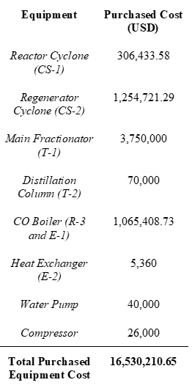
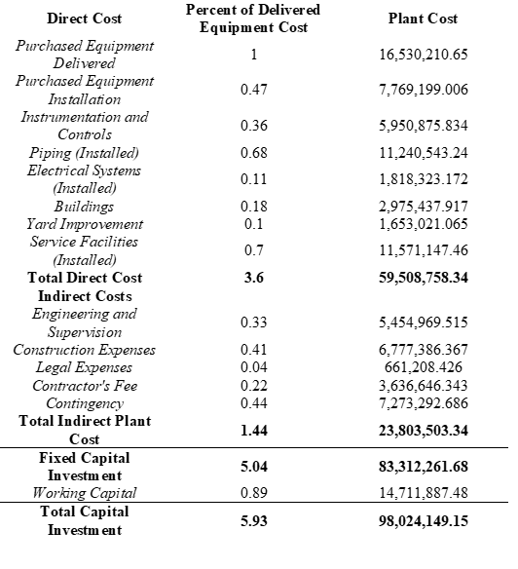
Economic Analysis (Capital Investment Summary)

Slide 32
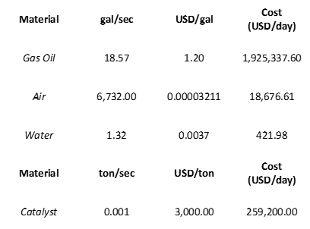
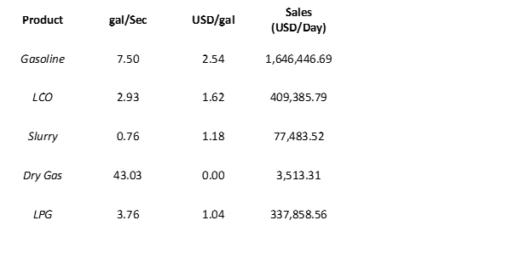
Materials and Products

Slide 33
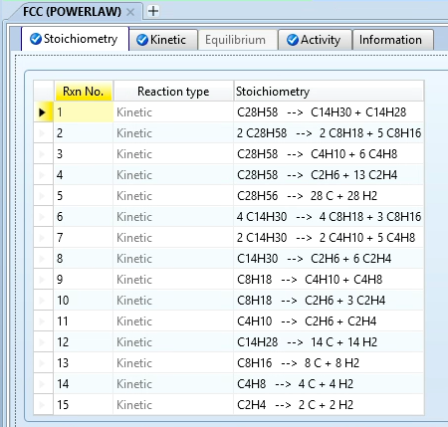
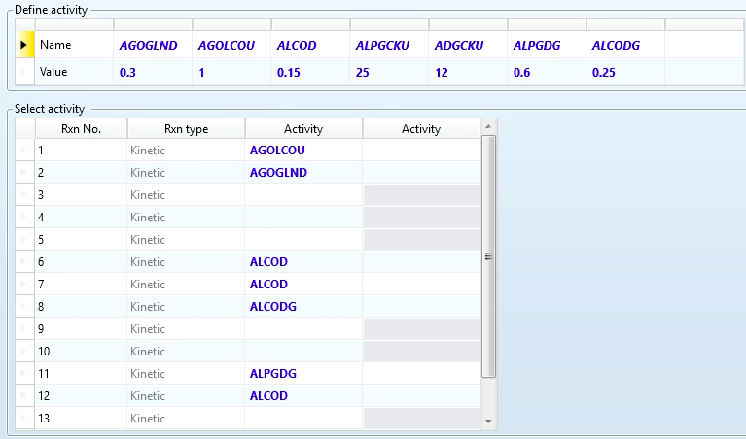
Incorporate activity factors
to model catalyst deactivation. Find a handbook with typical product yields corresponding to a set/range of operating conditions/parameters.
Then, employ trial-and-error.
Yields were compared to yields reported in literature (ensure realistic product output). Bumping down GLN caused the other component yields to change (i.e., they were “fixed”).

